Slide 1

INTRO TO CURRICULUM REFORM

Slide 2
WHY DO CURRICULUMS NEED TO CHANGE?
About half of medical schools in the US do not cover or offer only one lecture on abortion according to a 2020 study conducted by Stanford
Only about 1/3 cover pregnancy options counseling
Post-Roe abortion restrictions and state legislation targeting abortion education in medical schools has made it even more difficult for students to learn how to provide abortions

Slide 3
BASELINE CURRICULUM
Pregnancy options counseling
Contraception counseling
Pharmacology of contraception/EC and medication abortion
Basic statistics of abortion
Epidemiology of unintended pregnancy
Spontaneous abortion diagnosis and management
Surgical abortion techniques
Sexual health (all genders)
Ethics of abortion and physician responsibility
LGBTQ+ and gender nonconforming reproductive health
Abortion access and legal landscape Post-Roe

Slide 4
WHAT KIND OF CHANGES DO MSFC CHAPTERS MAKE?
Creating LGBTQ+ repro health and pregnancy termination seminars on campus at different medical schools in Ireland (Trinity College Dublin)
Adding a lecture on abortion (University of Kansas)
Adding a family planning elective (Temple University & Texas A&M University)
Adding a service learning elective (Boston University)

Slide 5
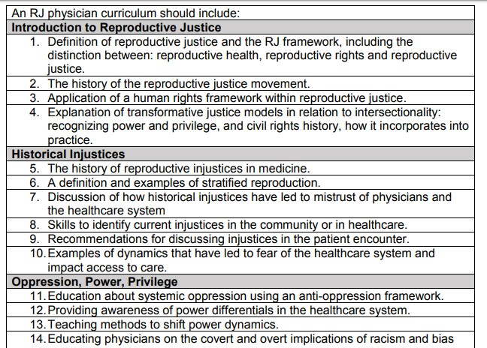
THINKING BIGGER- REPRO JUSTICE CURRICULUM

Slide 6
WHO HAS INFLUENCE ON THE CURRICULUM?
LCME (Liaison Committee on Medical Education)
Dean’s office
Faculty
National, state, and local legislatures
The public
Students!

Slide 7
STRATEGY
Evaluate your Curriculum
Identify Goals
Gather Support & allies
Research and Create a Realistic Proposal
Present Your Case
Follow up and be persistent

Slide 8
TIPS FOR SUCCESS
Start early
Have a realistic proposal
Maintain continuity
Don’t give up! Be persistent

Slide 9
GROUP DISCUSSIONS
What is abortion/repro health education like at your school?
What changes would you like to see?
What challenges do you foresee?
How can you overcome these?

Slide 10
WHAT RESOURCES ARE AVAILABLE?
Sample Surveys
Sample course proposal & description
Sample letter to admin
Tips for talking about abortion
Curriculum content
Listserv and Slack spaces
MSFC is always here to help! Email us at students@msfc.org

